Slide 1
Economic Value Out of Ideas
Moving forward in implementing Bangladesh’s Vision 2041
Md. Rifat Ahmed
ID: 1931725042

Slide 2
Did You Know?
Bangladesh has set a Vision for being a High-income country by 2041

Slide 3
It has rose over 2000$

Slide 4
Now the Big Question is How?

Slide 5
Bangladesh has over a 50million Students!
BUT
With the growing number of Unemployed Graduates How will Bangladesh Create Economic Value Out of Graduates?

Slide 6
And the Solution Is
Targeting to Create Economic Value Out of Ideas by Leveraging Information Technology (IT) Possibilities

Slide 7
Solution
Create Economic Value out of Ideas by Leveraging Information Technology (IT) Possibilities
Direct job creation
Workforce transformation
IT↑
Contribution to GDP growth
Emergence of new services and industries
Business innovation
Emergence of New Variables in the Market

Slide 8
BUT then Comes
The Middle Income Trap
Less Developed countries often Fall Victim to it which can be Avoided by Creating Value Out of Ideas

Slide 9
Endless Prosperity
Per Person Prosperity
Different Ideas leading to Different levels of Growth
N L K I
Means of Wealth Creation

Slide 10

Economic Growth through
Successive Reinventions
Semiconductor Industry has seen 3 new waves of Reinventions which is a Prime example of Creating Economic Value through Ideas

Slide 11
Creating & Leveraging Ideas
Taiwans’s TSMC rose the 4th wave due to popularity of Mobile phone chips
Rise of USA’s semiconductor due to PC wave
Japan’s Consumer Electronic Wave
Evolution of Semiconductor Waves
US Military application Wave
Time

Slide 12

Indias Struggle
India Produces 94% of the mobile Phones in their Country, but the Value Added is Just 20%!

Slide 13
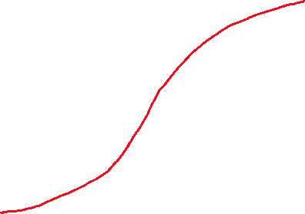
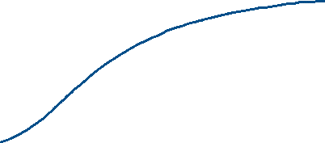
Idea Growing Economy vs Labor Intensive Economy
Idea Growing Economy (followed by USA, Japan)
Economical Growth
Labor Intensive Economy (followed by India)
Time

Slide 14
Ideas out of IT Possibilities
QUALITY ↑
COST ↓
IDEAS
IT offers the Option of Creating Ideas to Improve the Quality of a Product while Reducing its Cost

Slide 15
Transition for meeting Bangladesh’s vision
Innovation
Reinvention
Substitution
Replication & Imitation
Ideas

Slide 16
Focus for Transition
To get to 12000$ per capita from 2000$ the Focus should be on making the transition from labor to knowledge to create economic value out of ideas – by leveraging IT Possibilities

Slide 17
For More Details Visit the Website
Economic Value Out of Ideas - THE WAVES (the-waves.org)

